Slide 1
AI-Systems Efficient ML (294-162)
Amir Gholami & Joseph E. Gonzalez

Slide 2
Acknowledgments
Many slides from Jonathan Frankle, Prof. Kurt Keutzer, Pallas Group

Slide 3
Agenda for Today
1:10-2:00: Efficient ML and Ideas in ML Frameworks
2:00-2:45: PC Meeting Discussions
2:45-3:00: Break
3:00-4:00: Guest Lecture by Tianqi Chen

Slide 4
Objectives For Today
Get a good understanding of Pruning:
Methods for pruning applied to Inference
Pruning for efficient Training (Lottery Hypothesis Ticket)
Learn About Quantization
Integer-only Quantization
Mixed Precision Quantization
Important Ideas in ML Frameworks

Slide 5
Efficient ML with Pruning
Most of the slides in this section are courtesy of Jonathan Frankle [Harvard/MosaicML]

Slide 6
Neural Network Training is Costly
Research Questions:
Fundamentally do we need such large models to learn the representations that we are looking for?
Can we reduce this cost without sacrificing accuracy?
Amir Gholami, Zhewei Yao, Sehoon Kim, Michael W. Mahoney, Kurt Keutzer, AI and Memory Wall, Riselab Medium Blogpost, 2021.

Slide 7
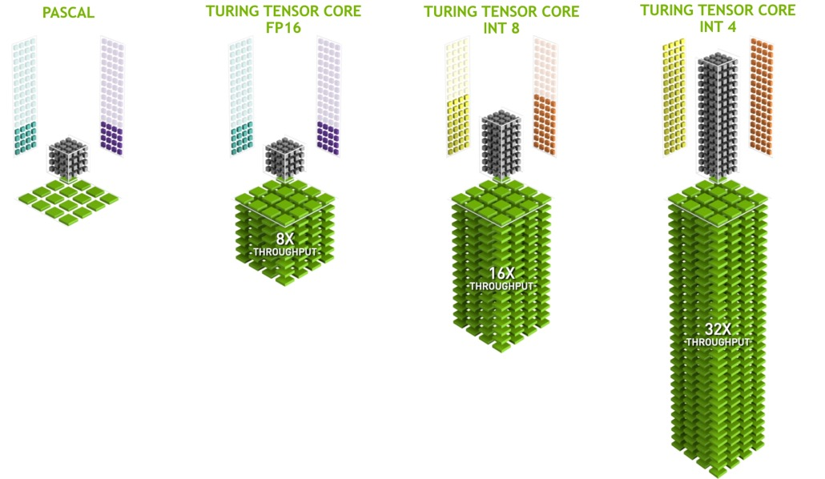
Reduced Precision Training
As we saw in lec 2, we have been very successful in FP16 training which enabled 10x improvements in throughput
But it has been very difficult to go to reduce the precision further
INT8/4 training often leads to significant accuracy degradation and is still an open research problem

Slide 8
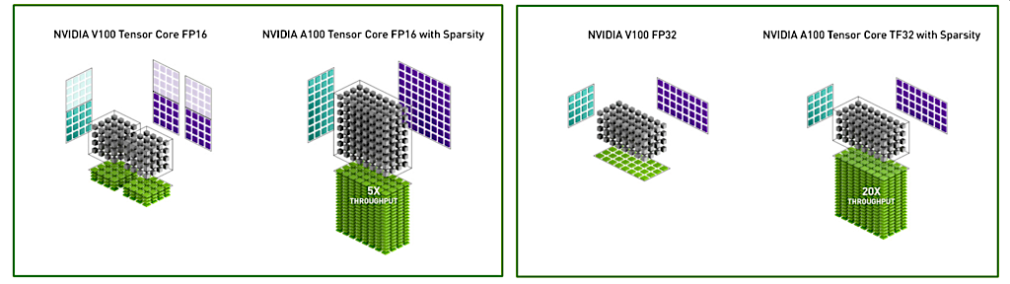
How about Utilizing Sparsity?
New HW generations such as A100 have built-in support for accelerating sparse workloads
HW vendors can achieve significantly higher gains if sparse training becomes feasible for ML like FP16

Slide 9
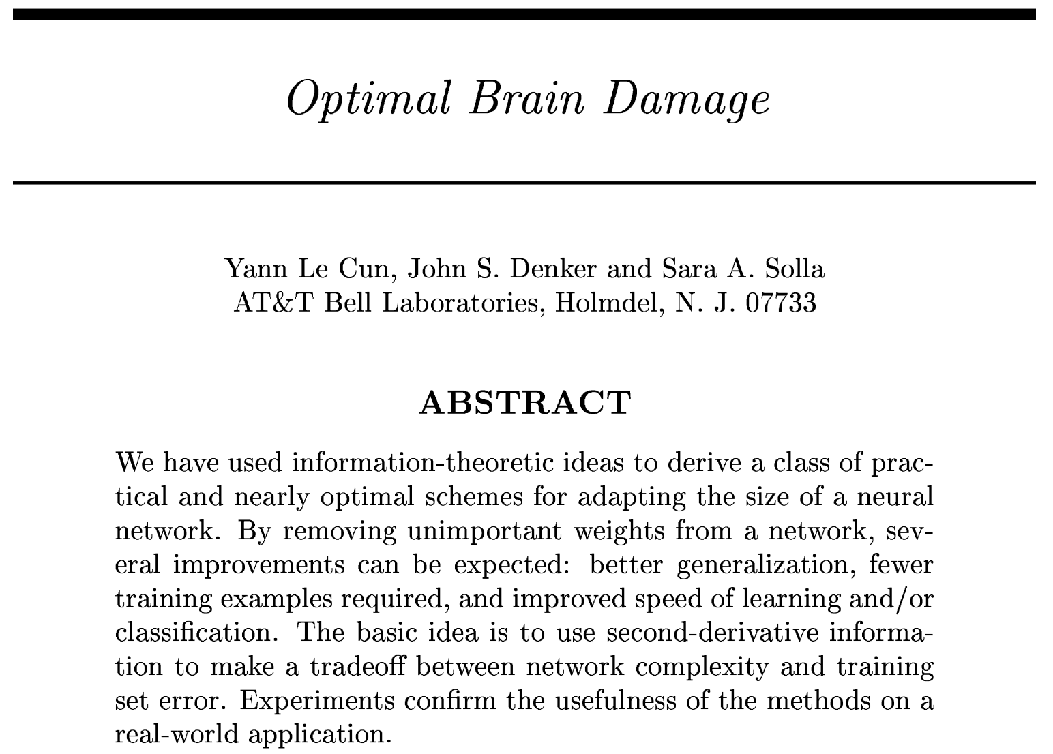
Sparsity: One of the Challenging Problems in ML
1990

Slide 10
Background: Neural Network Pruning
prune /pru:n/ verb
To reduce the extent of [a neural network] by removing superfluous or unwanted parts.
(Oxford English Dictionary)
Goal: reduce the cost of inference and/or Training
Slides: Courtesy of Jonathan Frankle

Slide 11
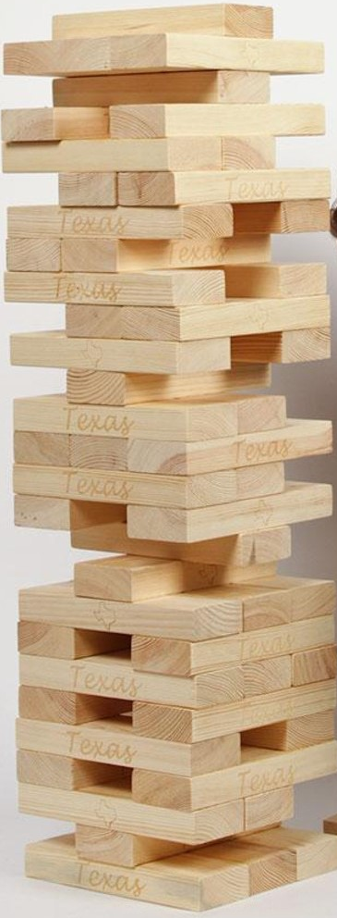
Background: Neural Network Pruning
Pruning similar to the Jenga game. We only remove blocks that are not sensitive.
Popular metrics for measuring sensitivity:
Magnitude
Gradients
Hessian
Image from UniversityCoop
Yu S*, Yao Z*, Gholami* A, Dong Z*, Mahoney MW, Keutzer K. Hessian-Aware Pruning and Optimal Neural Implant. WACV, 2022.
LeCun Y, Denker J, Solla S. Optimal brain damage. Advances in neural information processing systems. 1989.

Slide 12
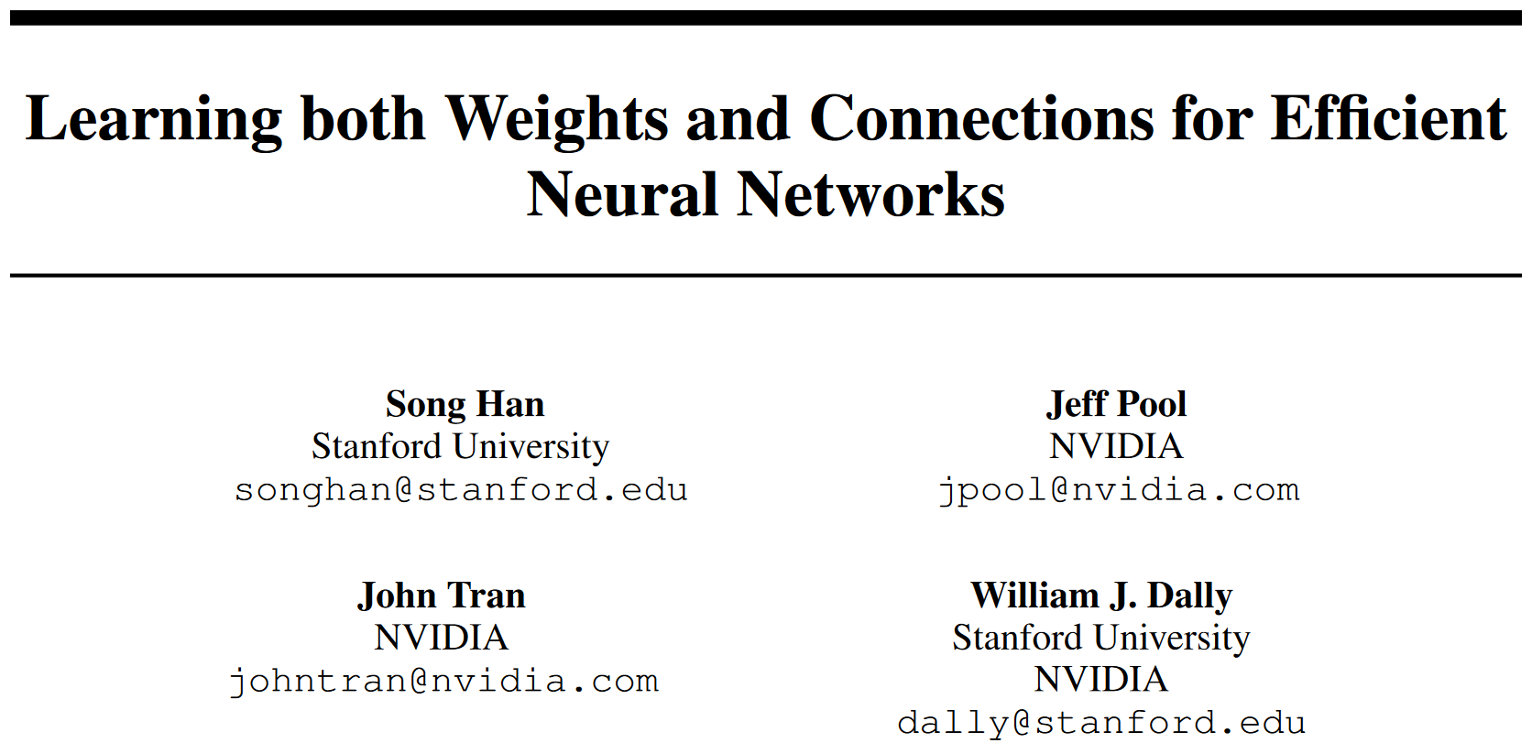
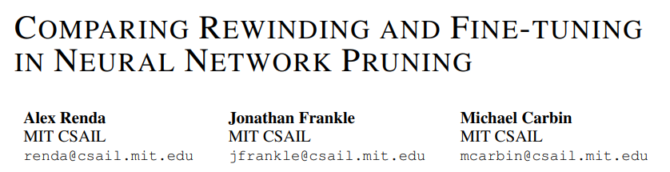
Background: Neural Network Pruning
Pruning similar to the Jenga game. We only remove blocks that are not sensitive.
There are many metrics for measuring sensitivity:
Magnitude
Gradients
Hessian
Image from UniversityCoop
Yu S*, Yao Z*, Gholami* A, Dong Z*, Mahoney MW, Keutzer K. Hessian-Aware Pruning and Optimal Neural Implant. WACV, 2022.
LeCun Y, Denker J, Solla S. Optimal brain damage. Advances in neural information processing systems. 1989.

Slide 13

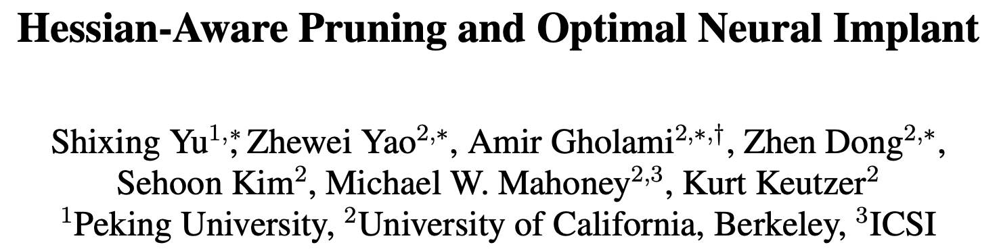
Background: Neural Network Pruning
Pruning similar to the Jenga game. We only remove blocks that are not sensitive.
There are many metrics for measuring sensitivity:
Magnitude
Gradients
Hessian
Image from UniversityCoop
LeCun Y, Denker J, Solla S. Optimal brain damage. Advances in neural information processing systems. 1989.
Yu S*, Yao Z*, Gholami* A, Dong Z*, Mahoney MW, Keutzer K. Hessian-Aware Pruning and Optimal Neural Implant. WACV, 2022.

Slide 14
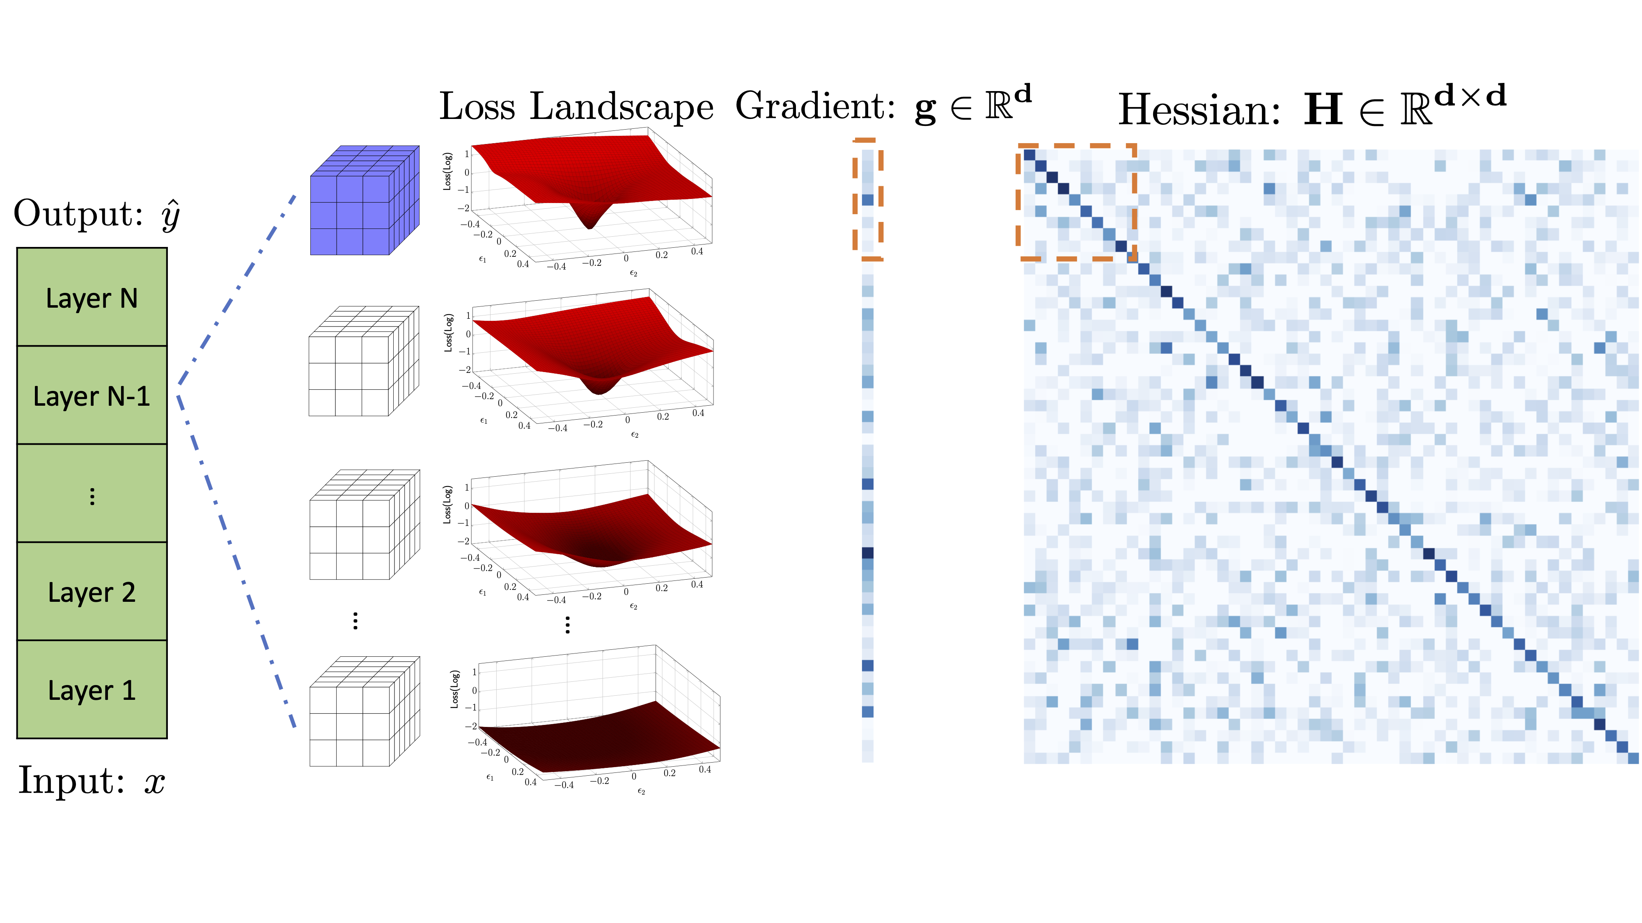

Hessian Aware Pruning
Why Second-order instead of magnitude pruning?
LeCun Y, Denker J, Solla S. Optimal brain damage. Advances in neural information processing systems. 1989.
Yu S*, Yao Z*, Gholami* A, Dong Z*, Mahoney MW, Keutzer K. Hessian-Aware Pruning and Optimal Neural Implant. WACV, 2022.
Yao Z*, Gholami A*, Keutzer K, Mahoney M. PyHessian: Neural networks through the lens of the Hessian. AAAI, 2020.

Slide 15
Background: Neural Network Pruning
Train the network
Remove superfluous structure
Fine-tune the network
Optionally: prune and fine-tune iteratively
Randomly Initialized
Trained then Pruned
Fine-Tuned

Slide 16
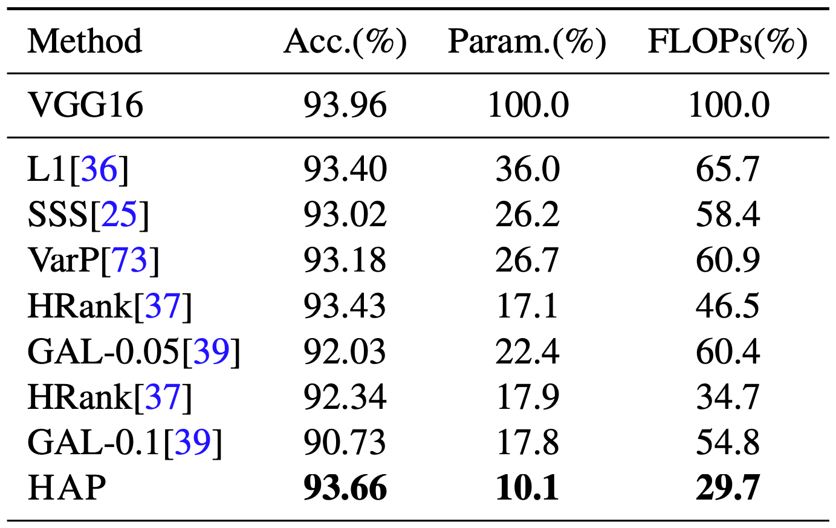
Pruning Can be Effective
If we can indeed find pruned models that achieve high accuracy that means that there exists sub-networks that have enough representational power.
Then why not sparse models to begin with?
Different structured pruning methods
Yu S*, Yao Z*, Gholami A*, Dong Z*, Kim S, Mahoney MW, Keutzer K. Hessian-Aware Pruning and Optimal Neural Implant. WACV, 2022.

Slide 17
Research Question
Research Question: If we can prune models after training, can we train smaller models?

Slide 18
Research Question: Training Sparse Models?
If we could train small models that are sparse from the beginning, then we can significantly reduce the cost of training

Slide 19
Research Question
If we can prune models after training, can we train smaller models?
Capacity for representation vs. optimization

Slide 20
Research Question
If we can prune models after training, can we train smaller models?
Capacity for representation vs. optimization

Slide 21
Research Question
If we can prune models after training, can we train smaller models?
Capacity for representation vs. optimization ??

Slide 22
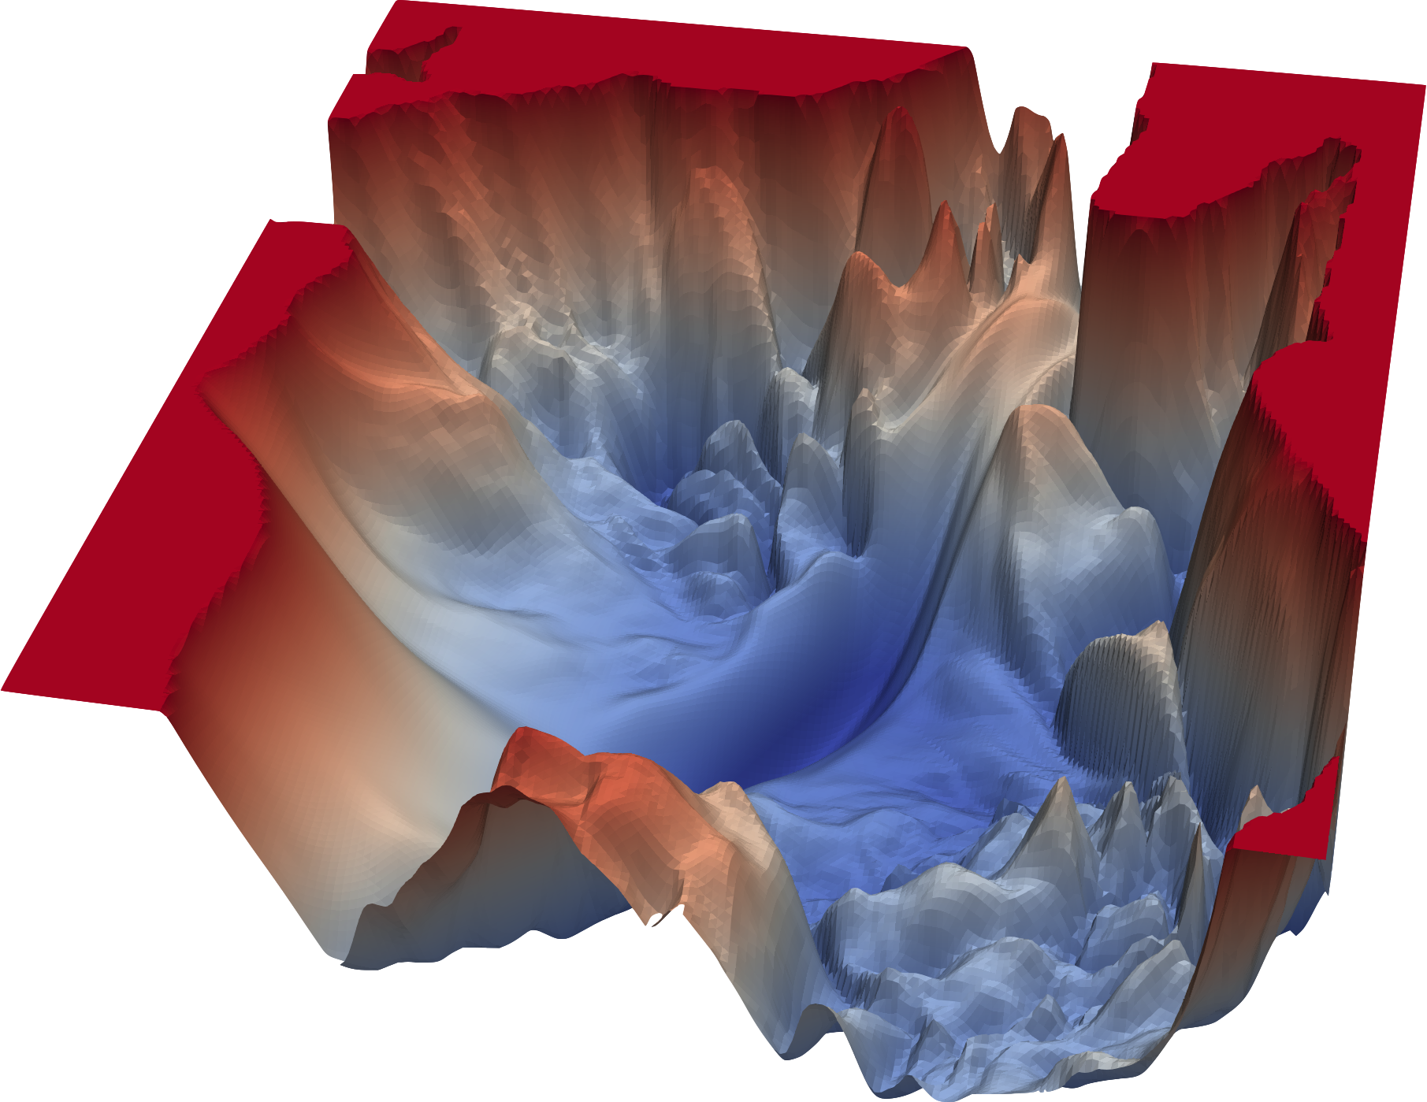
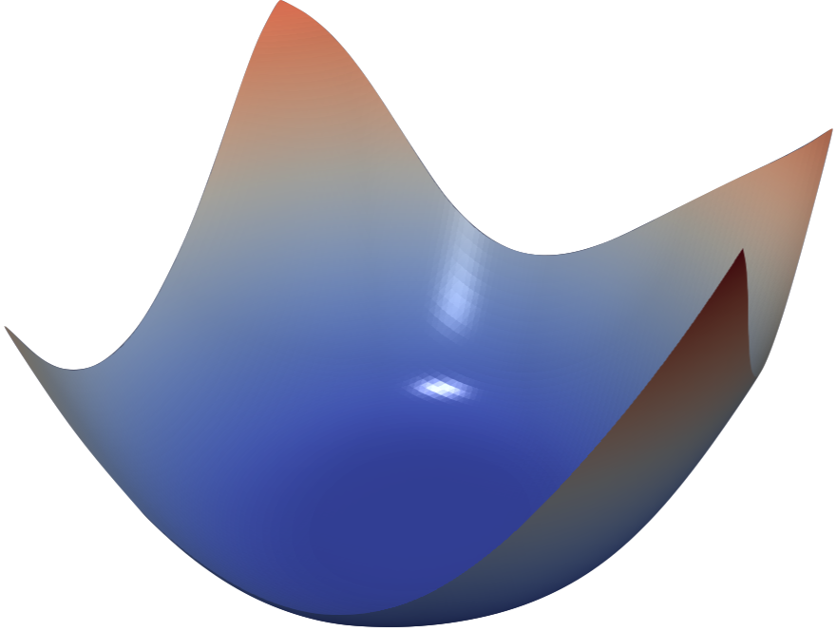
Overparameterized Models
Current Hypothesis: Empirical results have consistently been showing that large models are easier to train and generalize better
It appears as if adding more parameters makes the optimization problem easier
If this is true, then is training small models infeasible?
Adding more parameters
(Disclaimer: This hypothesis is highly debated and is not always true!)

Slide 23
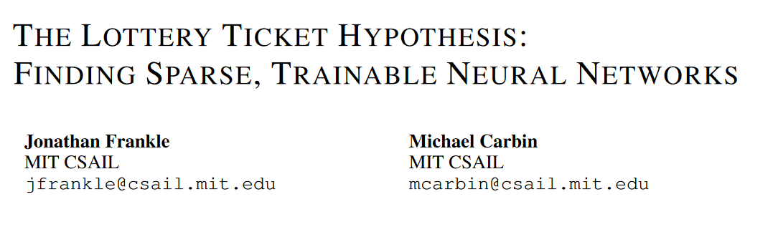
Is Training Small-Scale NNs Possible?
ICLR 2019

Slide 24
Attempting to Train a Pruned Network
Train the network
Remove superfluous structure
Randomly initialize the pruned network
Train it to convergence
Randomly Initialized
Pruned and Reinitialized
Pruned then Trained

Slide 25
Attempting to Train a Pruned Network
Train the network
Remove superfluous structure
Randomly initialize the pruned network
Train it to convergence
Does not reach full accuracy
Randomly Initialized
Pruned and Reinitialized
Pruned then Trained

Slide 26
Attempting to Train a Pruned Network
It is better to retain the weights from the initial training phase for the connections that survived pruning than it is to reinitialize.

Slide 27
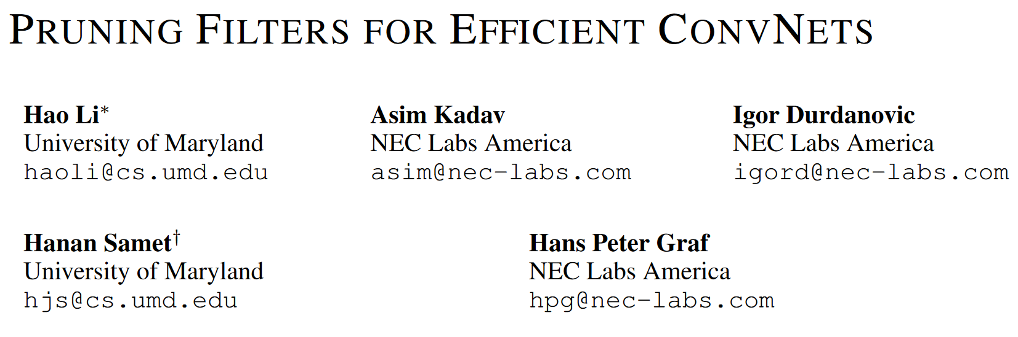
Attempting to Train a Pruned Network
It is better to retain the weights from the initial training phase for the connections that survived pruning than it is to reinitialize.
Training a pruned model from scratch performs worse than retraining a pruned model, which may indicate the difficulty of training a network with small capacity.

Slide 28
Attempting to Train a Pruned Network
It is better to retain the weights from the initial training phase for the connections that survived pruning than it is to reinitialize.
Training a pruned model from scratch performs worse than retraining a pruned model, which may indicate the difficulty of training a network with small capacity.

Slide 29
Iterative Magnitude Pruning (IMP)
Train the network
Remove superfluous structure
Reset each weight to its original initialization
Train it to convergence and repeat iteratively
Pruned at Initialization
Pruned then Trained

Slide 30
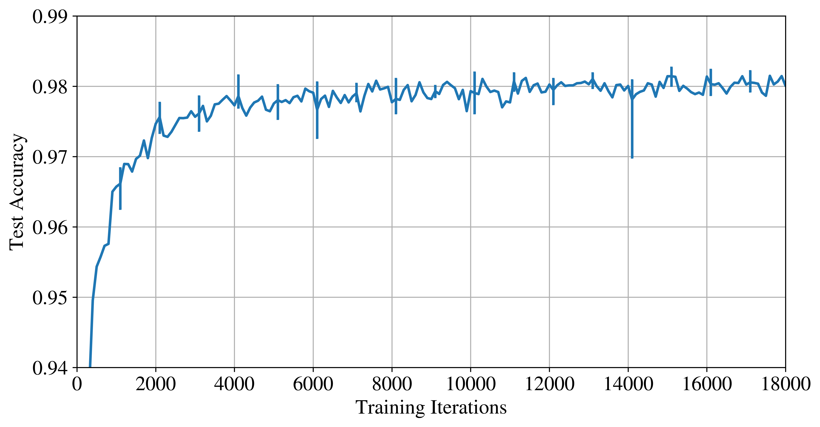
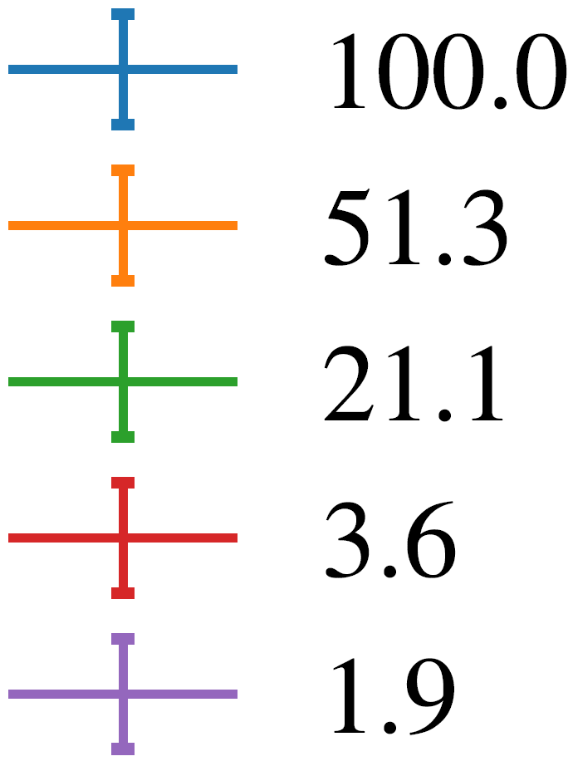
Results
100% Remaining
LeNet 300-100-10 for MNIST fully-connected 300K parameters

Slide 31
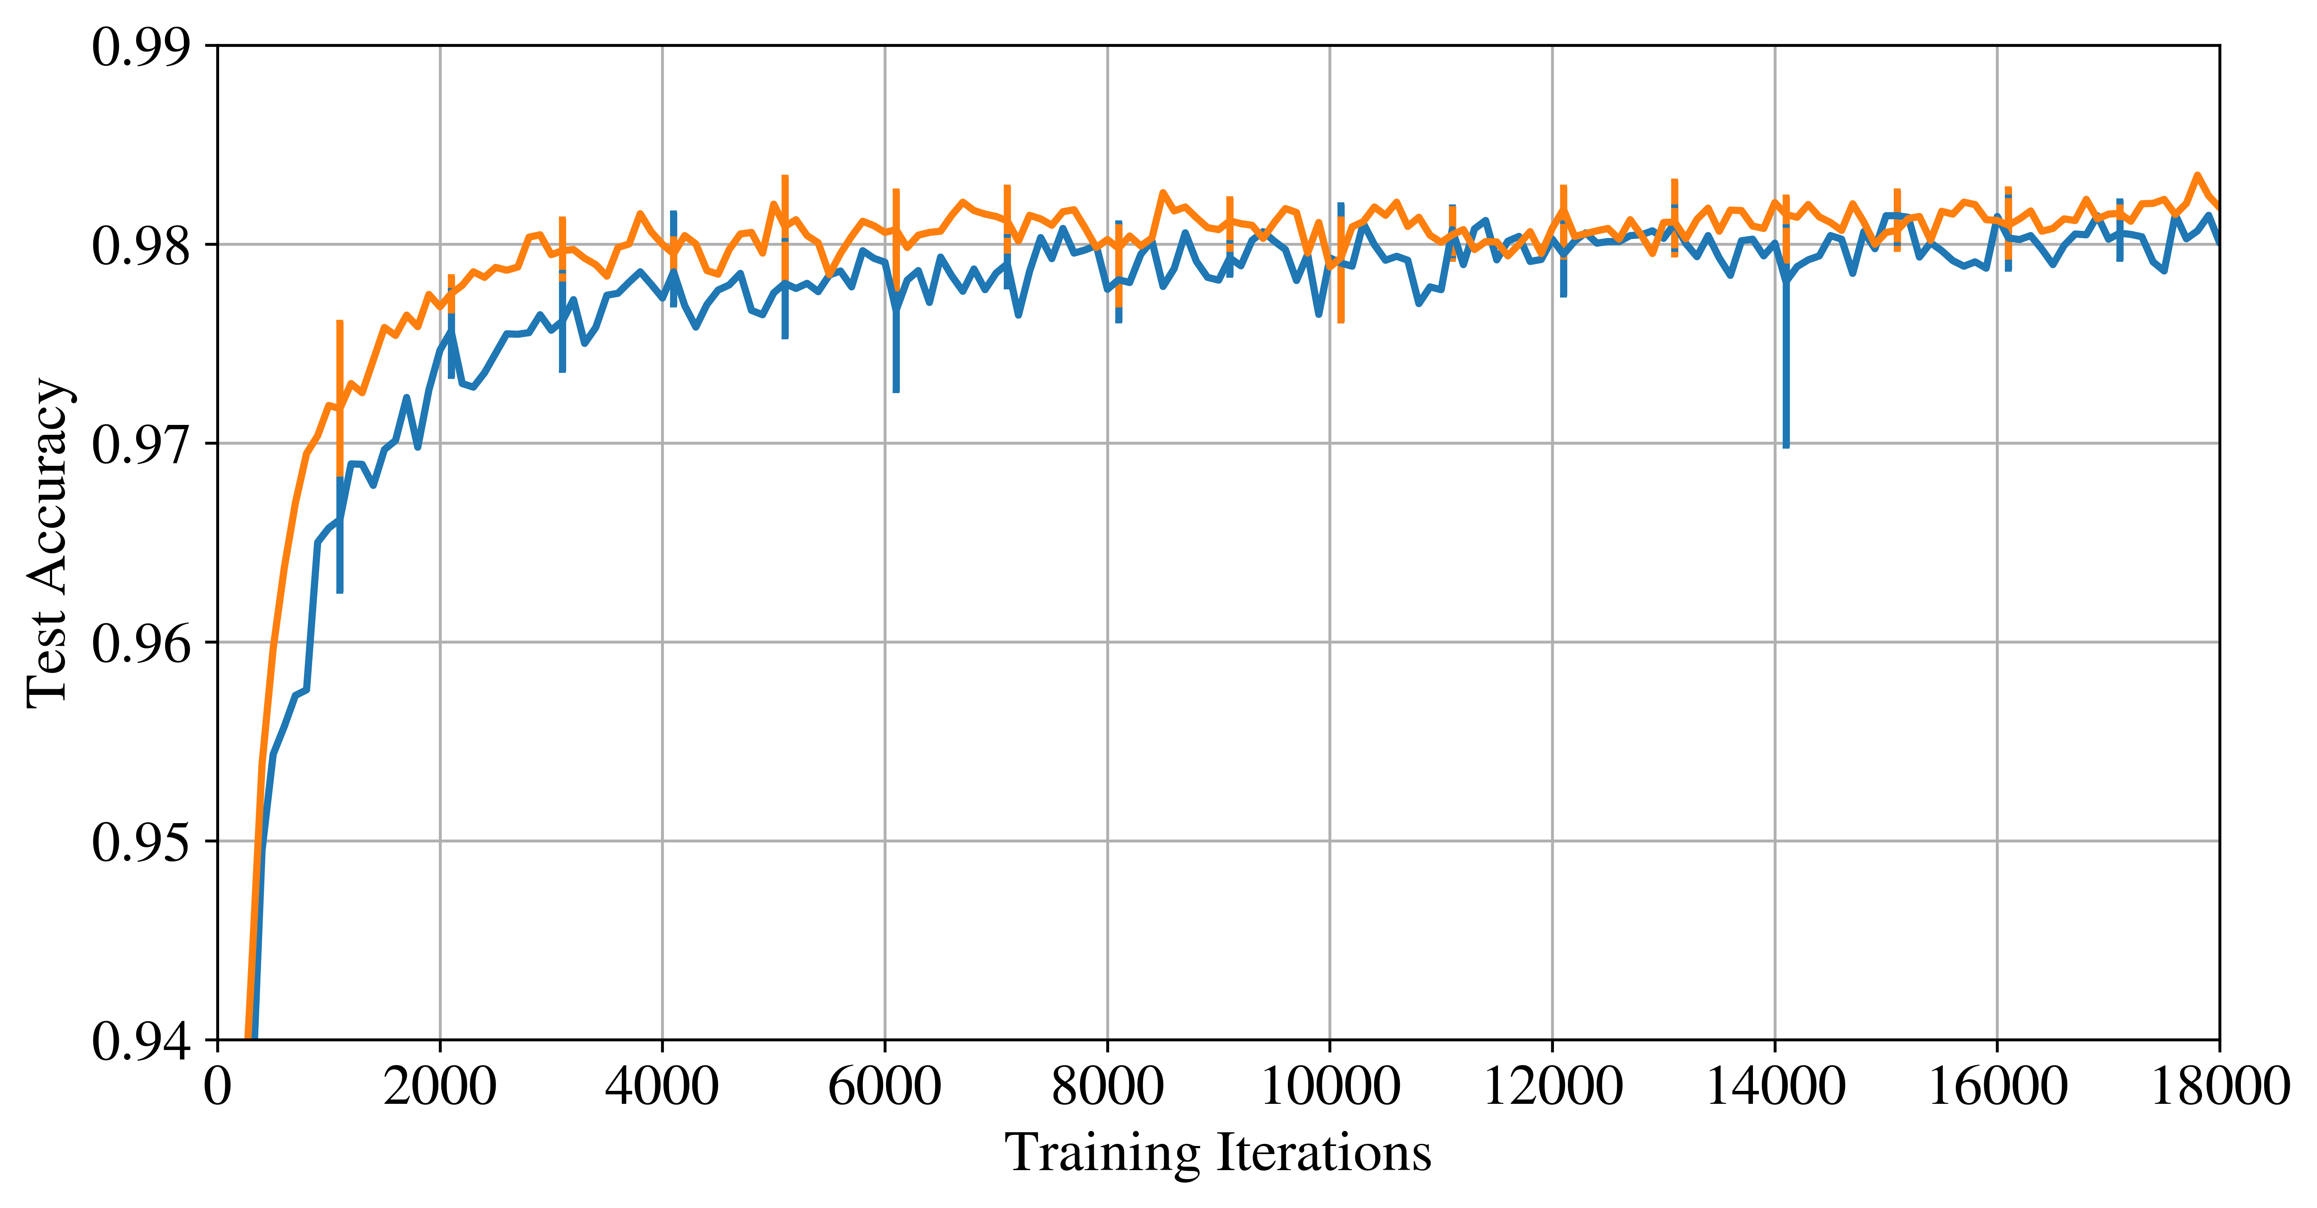
Results
100% Remaining
51.3% Remaining
LeNet 300-100-10 for MNIST fully-connected 300K parameters

Slide 32
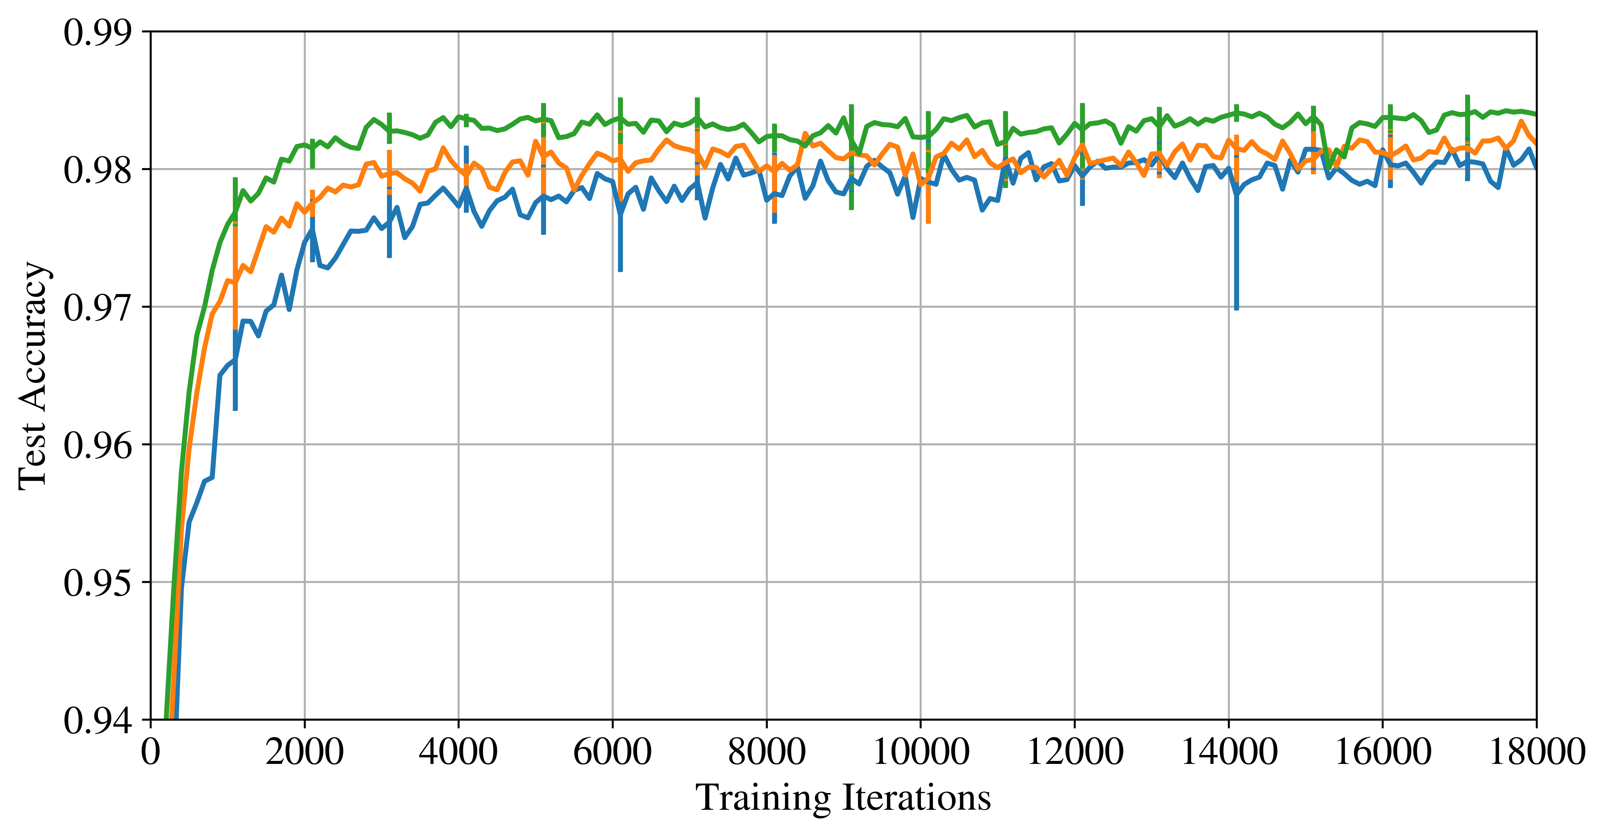
Results
100% Remaining
51.3% Remaining
21.1% Remaining
LeNet 300-100-10 for MNIST fully-connected 300K parameters

Slide 33
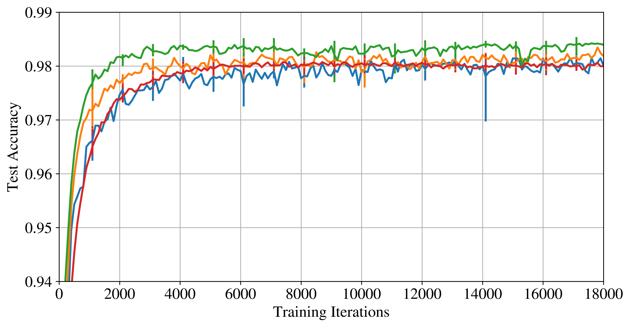
Results
100% Remaining
51.3% Remaining
21.1% Remaining
3.6% Remaining
LeNet 300-100-10 for MNIST fully-connected 300K parameters

Slide 34
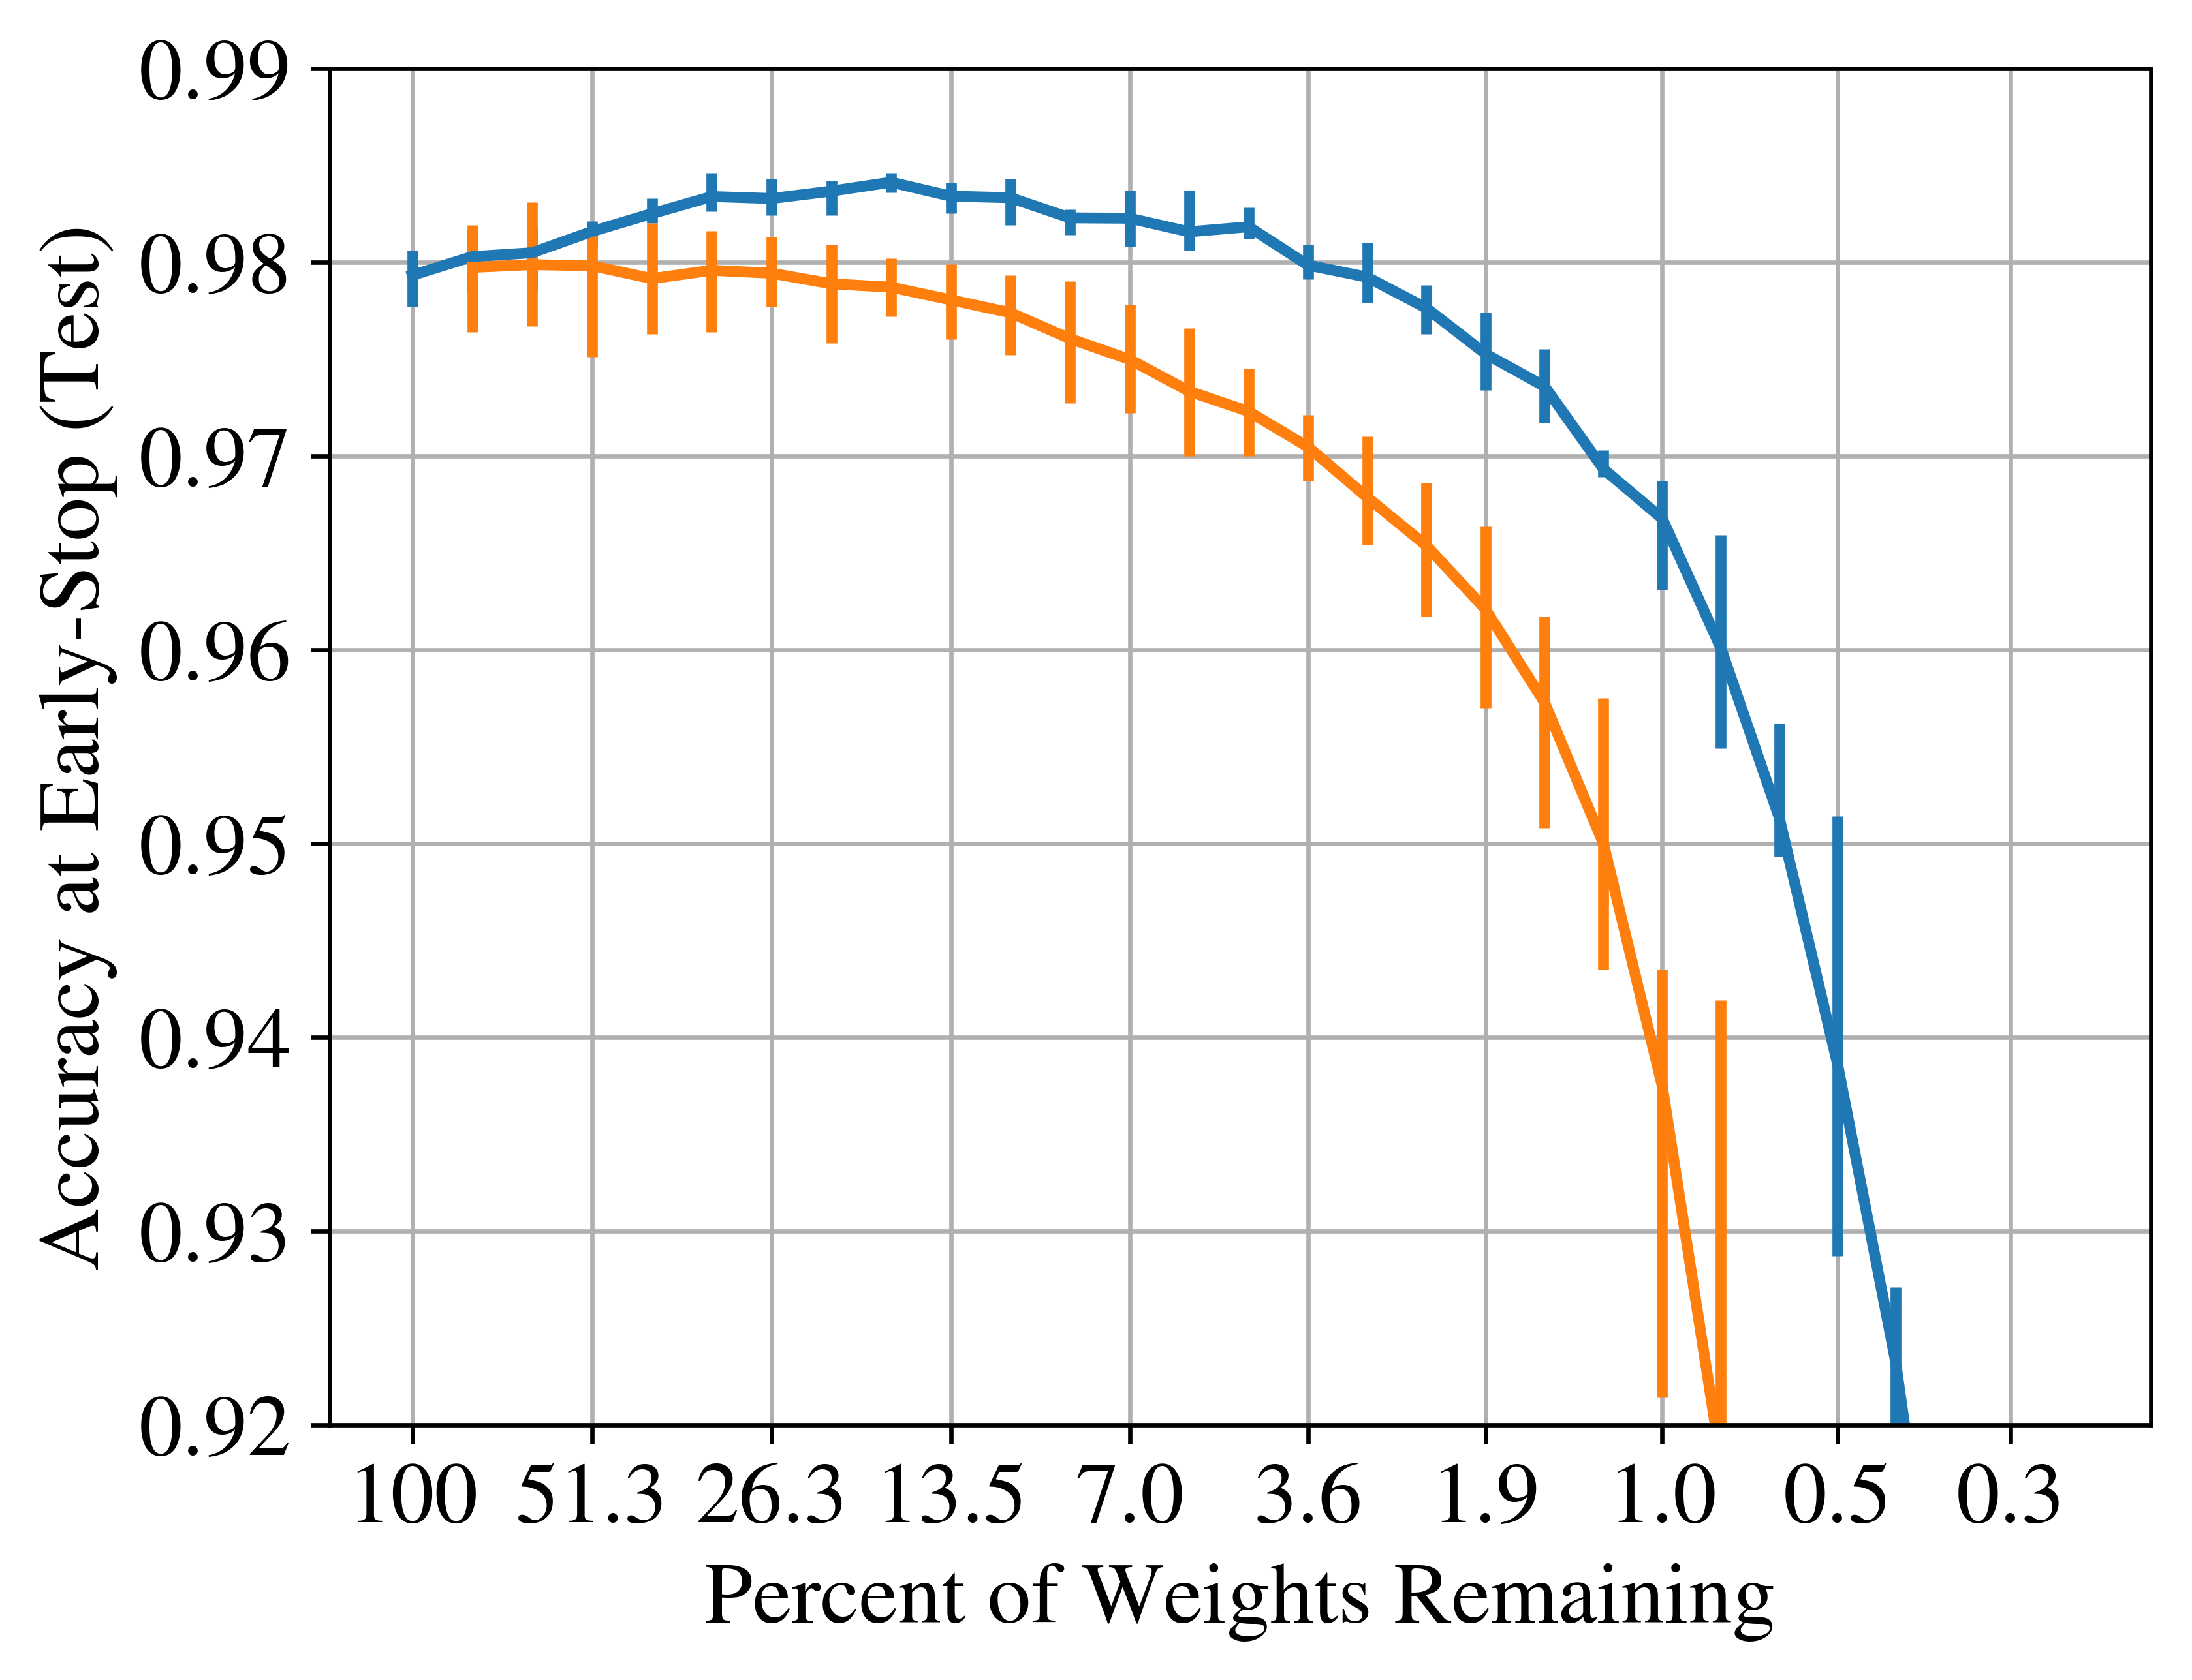
Results
original init
LeNet 300-100-10 for MNIST fully-connected 300K parameters

Slide 35
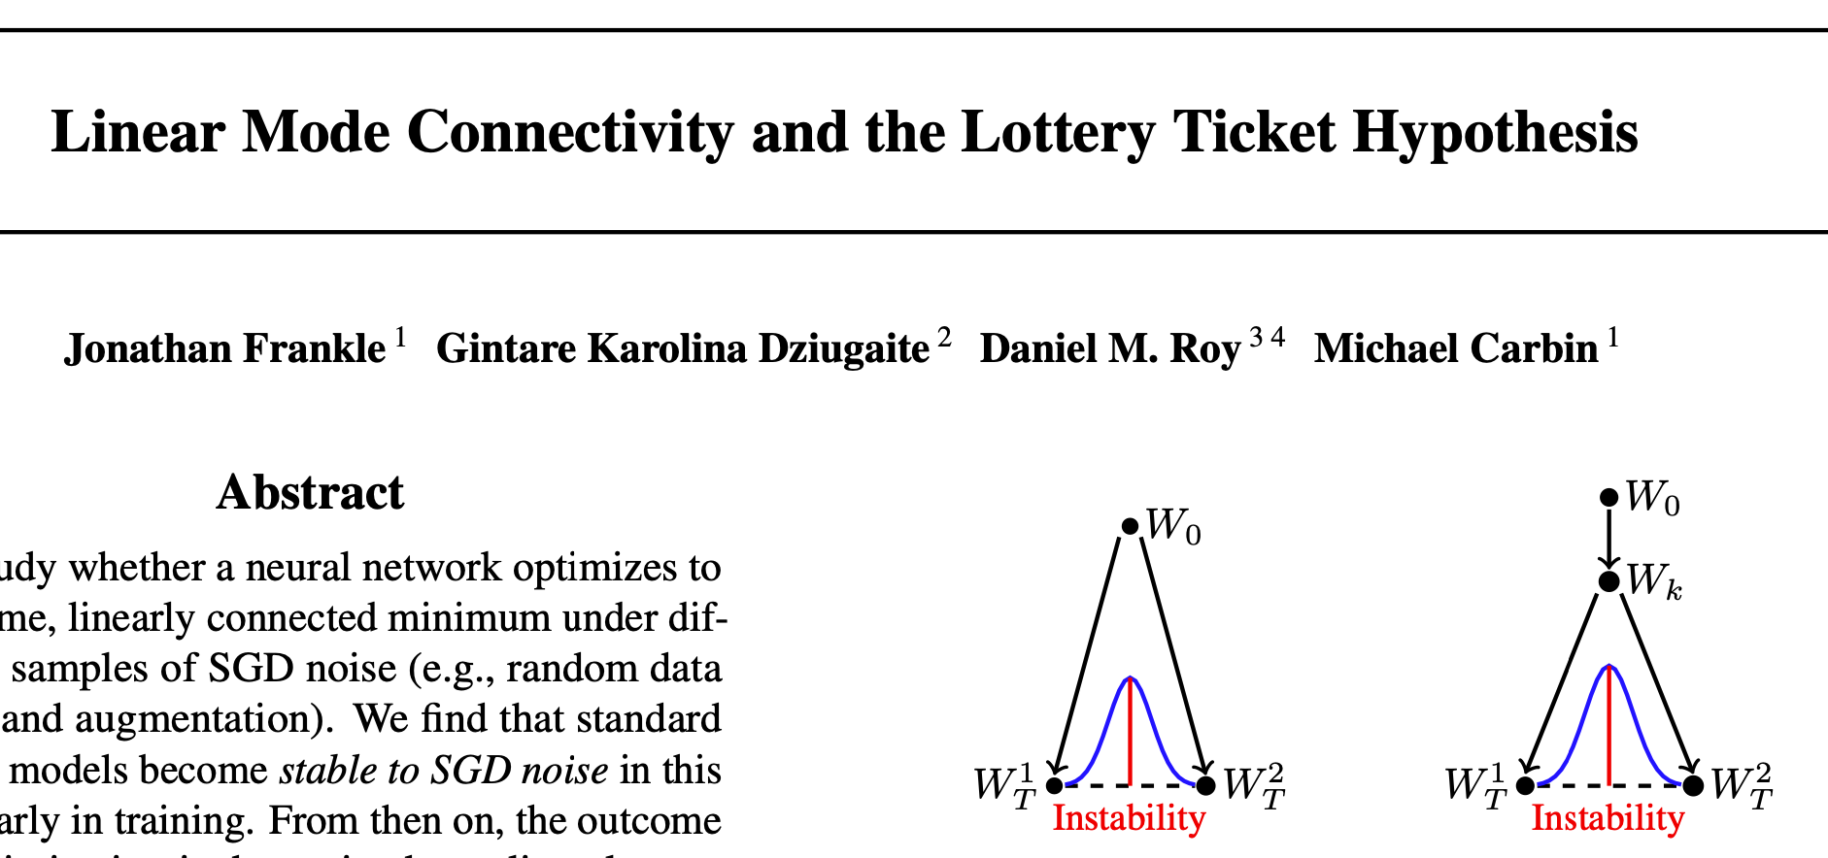
Limitations
Subnetworks are found retroactively
Exploiting pruning for better performance requires software and hardware support
Small, vision networks and tasks
Does not work for larger models and more complicated datasets
Stay Tuned for the PC Meeting

Slide 36
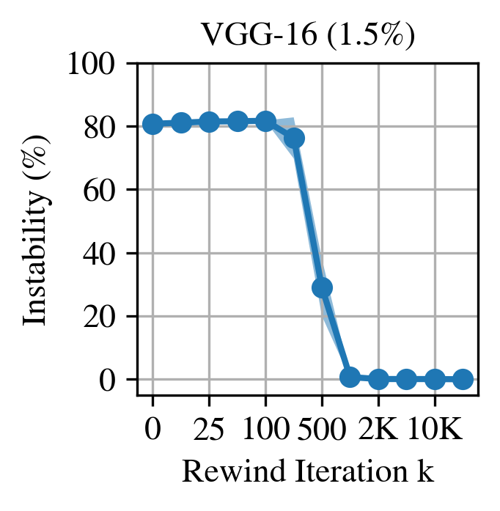
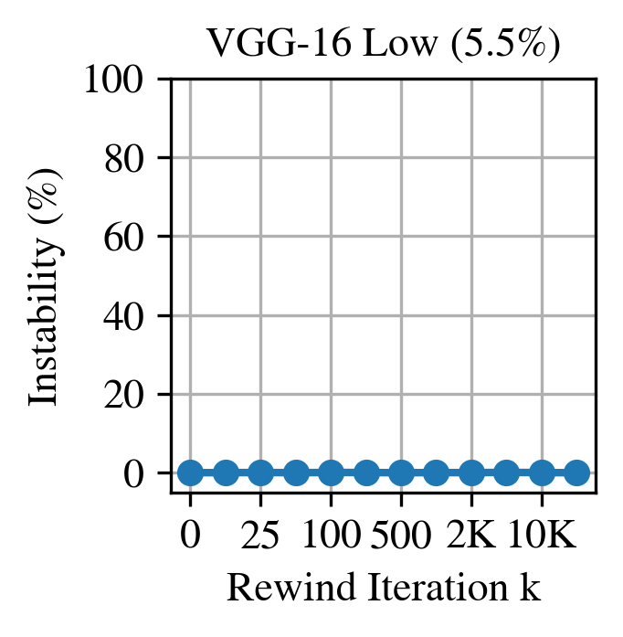
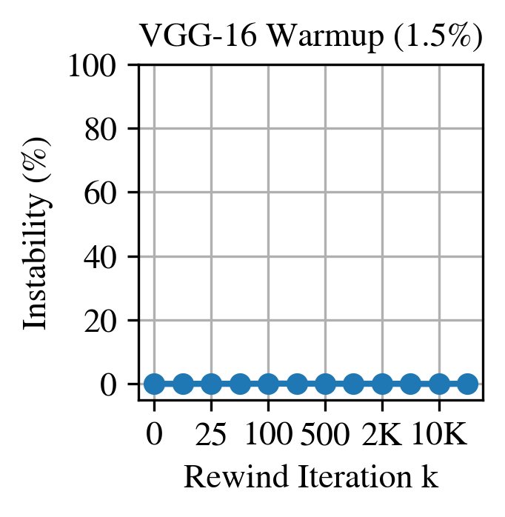
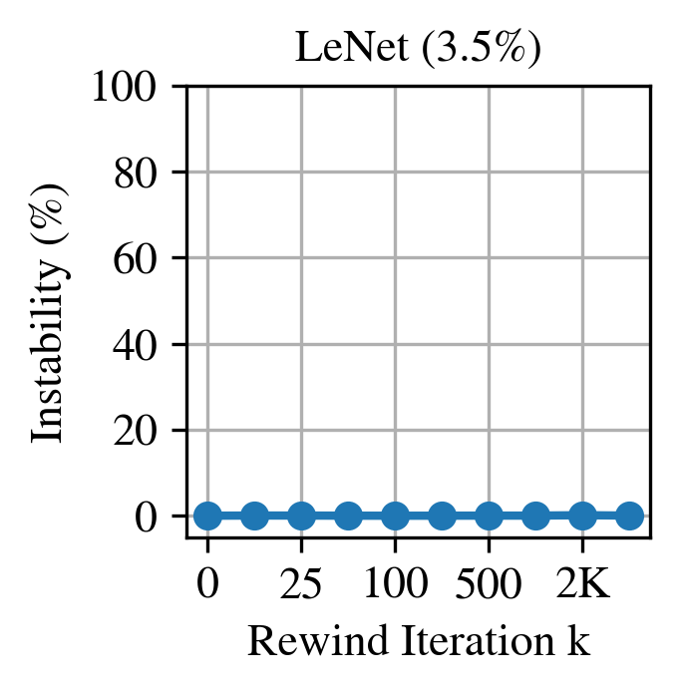
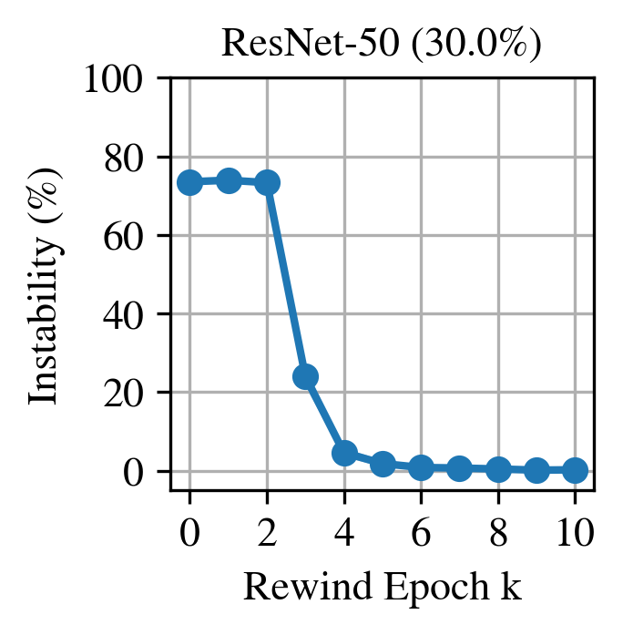
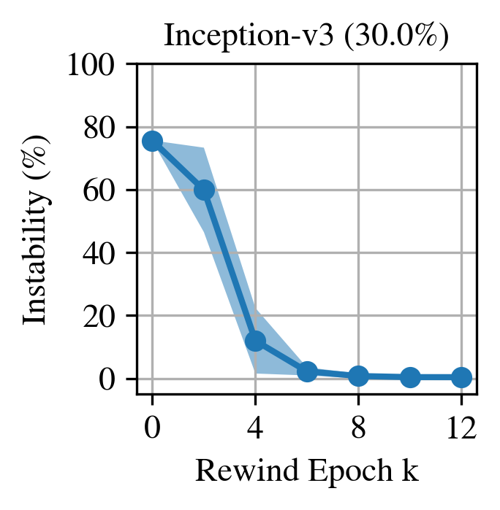
Sneak Peak of Results For More Complex Models/Datasets
IMP Succeeds
IMP Fails
Iteration 1K out of 62K = 1.6% into training

Slide 37
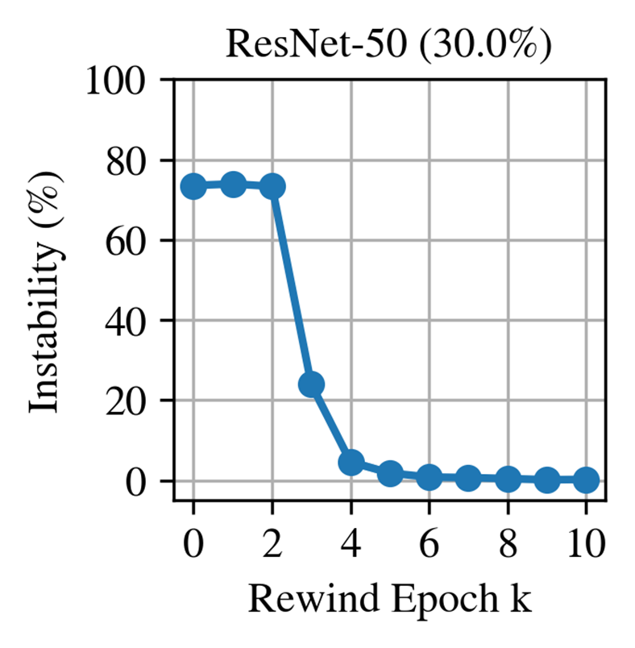
Sneak Peak of Results For More Complex Models/Datasets
IMP Succeeds
IMP Fails
Epoch 5 out of 90 = 5.5% into training

Slide 38
High Level Findings in the literature on this topic
Sparse subnetworks reach full accuracy:
In small networks, this occurs at initialization.
For large networks, this occurs early in training.
(we will see the details during the PC meeting).
But this alone does not help us improve the speed up training. However, this is an active area of research, and if we could find the lottery hypothesis ticket in a more efficient manner, then this could significantly improve training cost.

Slide 39
Another Limitation: Structured vs Unstructured Sparsity
Another Limitation
Unstructured Sparsity:
Enables significantly higher levels of sparsity (~5%)
Harder to accelerate in HW
Structured Sparsity:
Easier to accelerate in HW
Does not allow as much sparsity (~60%)
Unstructured
Sparsity
Structured
Sparsity

Slide 40
Further Reading
We only talked about weight sparsity, but there is a large body of work on activation sparsity, token pruning, training free pruning, …
If you are interested to learn more about pruning:
Sparsity in Deep Learning: Pruning and growth for efficient inference and training in neural networks
The state of sparsity in deep neural networks
What is the State of Neural Network Pruning?

Slide 41
Efficient ML with Quantization

Slide 42
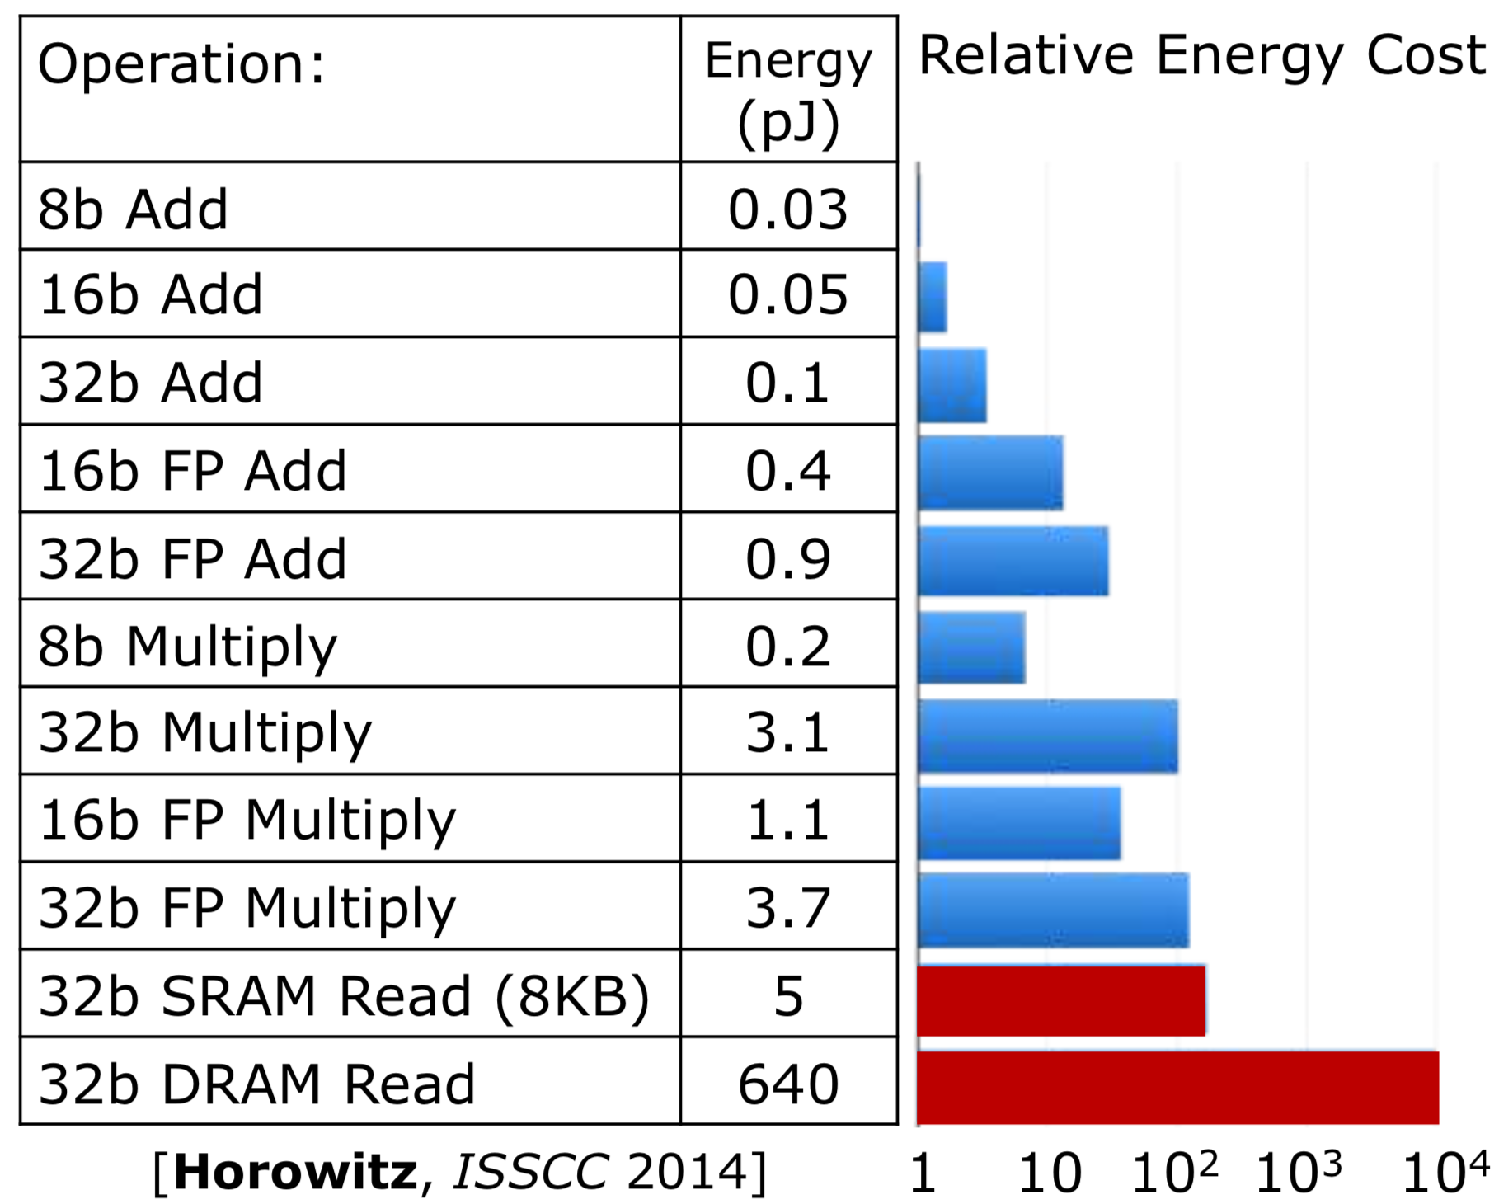
Quantization Enables Fewer Memory Accesses
Memory accesses are the principal cost in both latency and energy
Lower precision weights in DNN mean each memory access brings more data values
More data values few accesses overall
Image Credit: Sdxcentral, nvidia
Table credit: Mark Horowitz

Slide 43
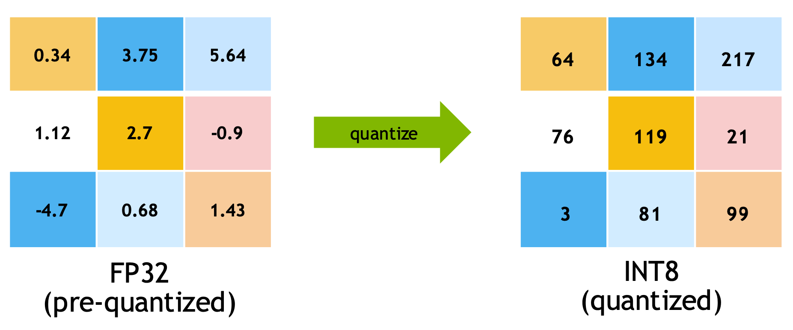
Quantization
Uniform quantization is a linear mapping from floating point values to quantized integer values
Floating Point Values
…
0 | 1 | … | 255
Less memory footprint
Faster inference on integer arithmetic units
8-bit Quantized Values

Slide 44
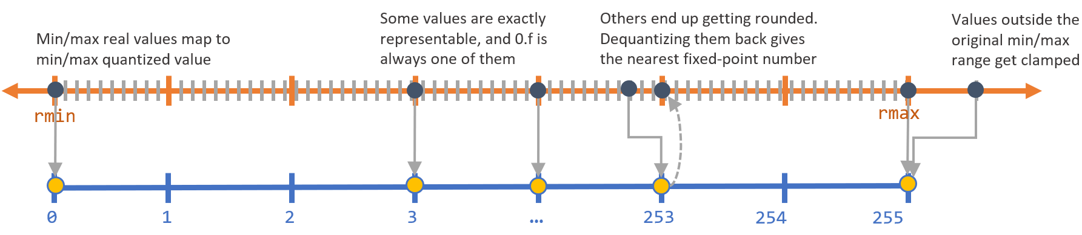


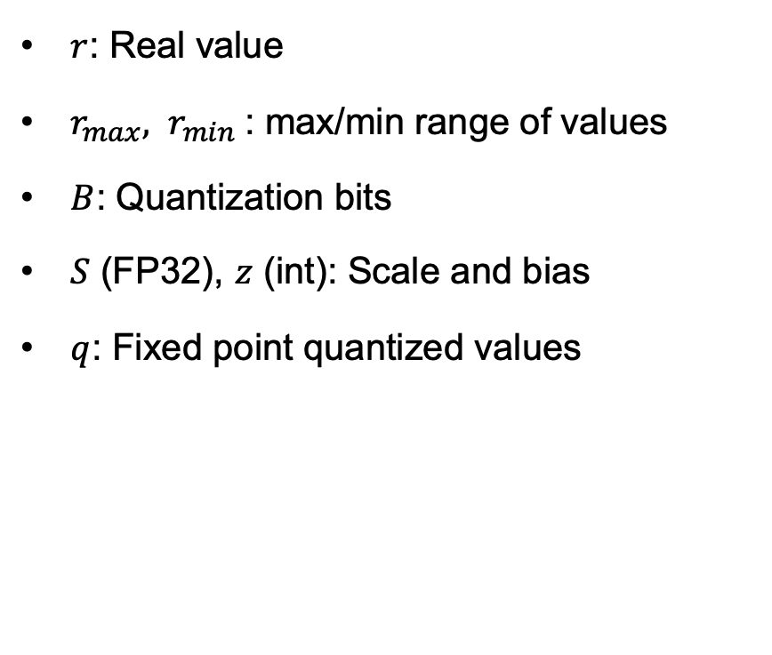
Uniform Quantization
$r$: Real value
$r_{max}, r_{min}$: max/min range of values
$B$: Quantization bits
$S$ (FP32), $z$ (int): Scale and bias
$q$: Fixed point quantized values
$$r=\frac{r_{max}−r_{min}}{2^B−1}\left(q−z\right)$$
$$r=S\left(q−z\right)$$
Uniform 8-bit Quantization
Illustration from Sahni Manas

Slide 45
Integer-only Quantization!
Key idea is to not fold BN during training and only do BN folding at the end, otherwise you will effectively be training a model without BN which is known to be hard to optimize
Notes:
y^{i4} = {Round}\big(\frac{S_wS_x}{S_y} W^{i4}x^{i4} + \frac{S_x}{S_y}x^{i4}\big)

Slide 46
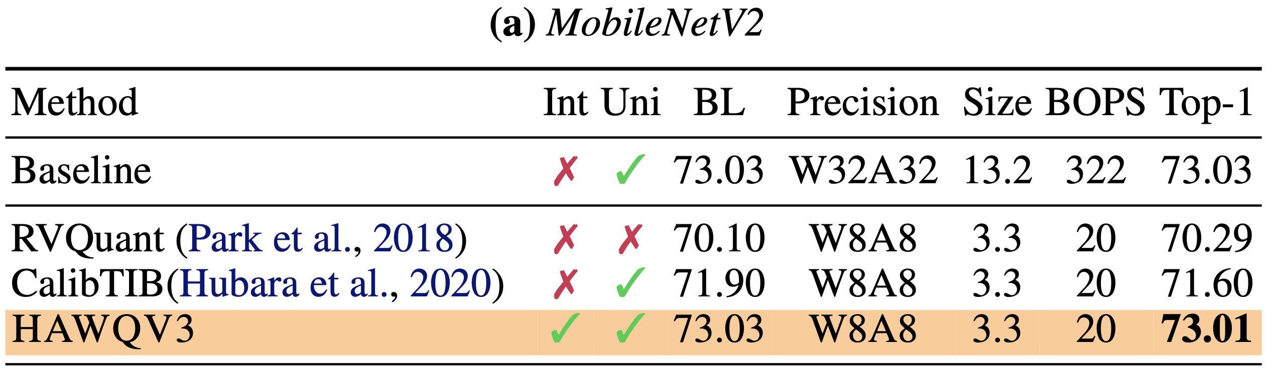
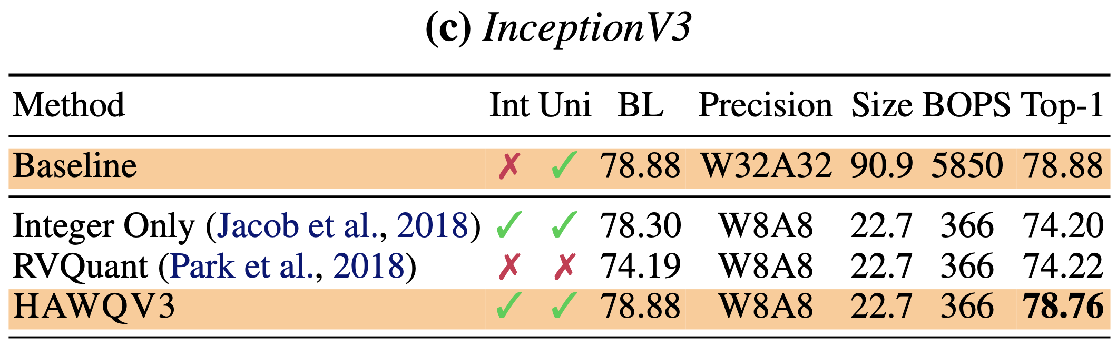
Integer-only Quantization Works
Almost not accuracy degradation
Almost not accuracy degradation
Z. Yao*, Z. Dong*, Z. Zheng*, A. Gholami*, E. Tan, J. Li, L. Yuan, Q. Huang, Y. Wang, M. W. Mahoney, K. Keutzer, HAWQ-V3: Dyadic Neural Network Quantization in Mixed Precision, ICML’21.
Online Code: https://github.com/Zhen-Dong/HAWQ

Slide 47
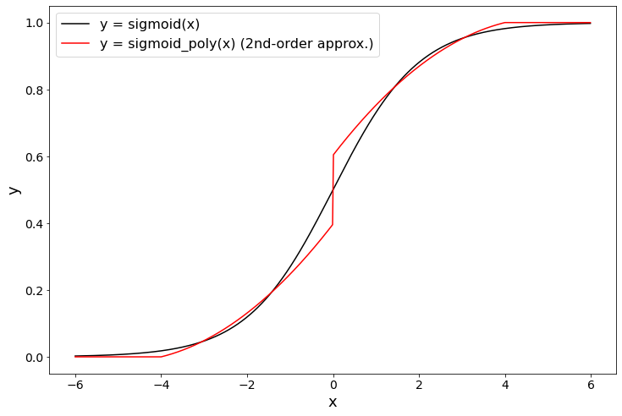
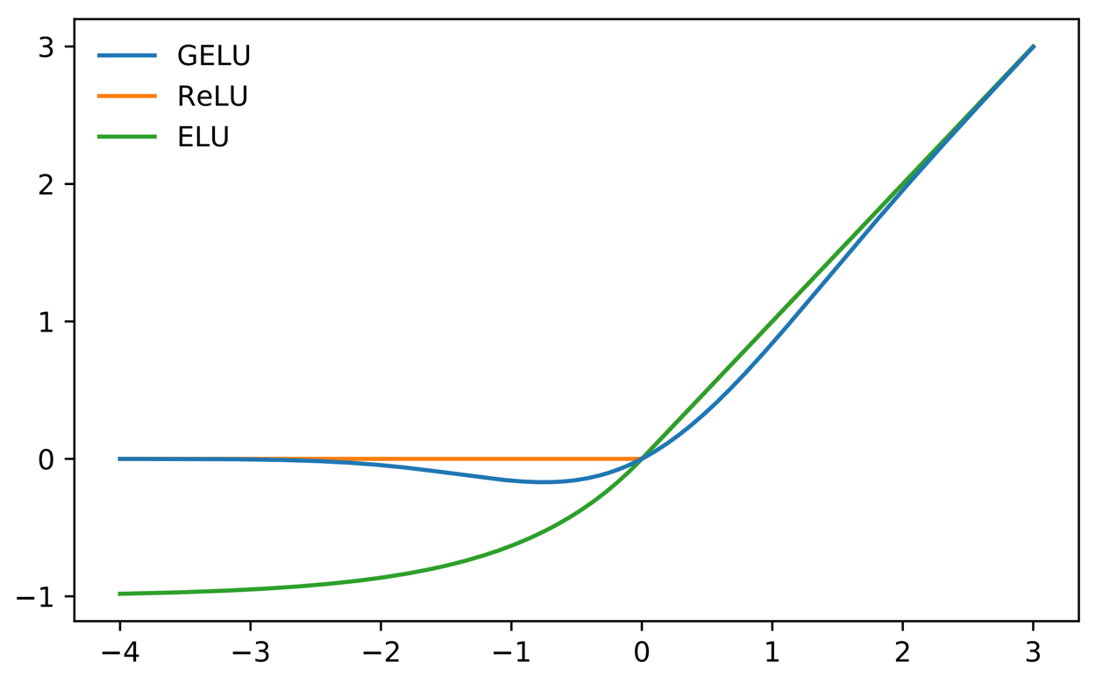
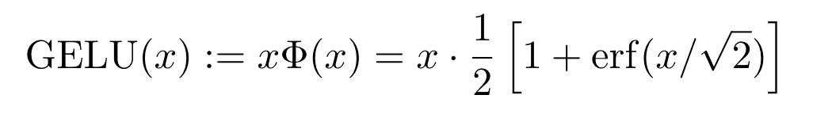
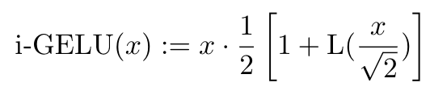
Integer-only Can be applied to general Non-Linearities
Proposed Solution: Approximate erf with 2nd-order polynomial
Real erf term
Real erf term
Approximated erf term
3. Symmetric extension
2. Clip
1. Interpolation
Approximated erf term
Can be computed with integer arithmetic

Slide 48
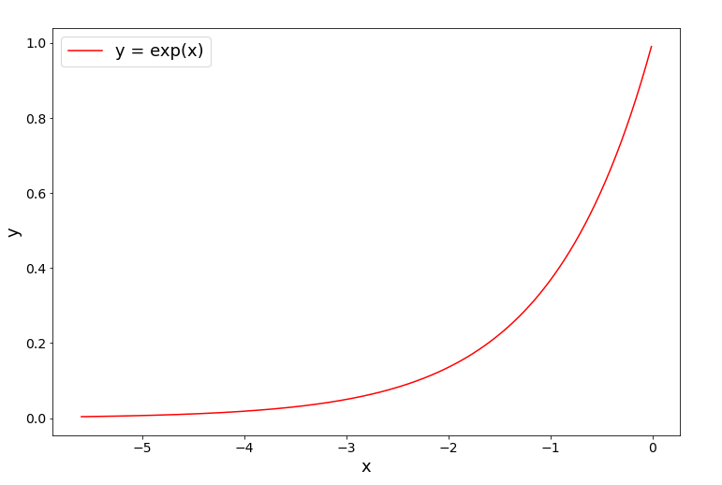
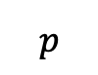
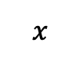
Integer-only Softmax
We can even approximate exp(x) with 2nd-order polynomials with very low error
Approximate exponential in the interval [-ln2, 0]
Quotient z: integer
Remainder p: lies in [-ln2, 0]
Compute with approximation
$$p$$
$$x$$
-ln2
Notes:
\exp(\tilde x) = 2^{-z} \exp(p) = \exp(p) >> z
\tilde x = (-\ln{2})z + p

Slide 49
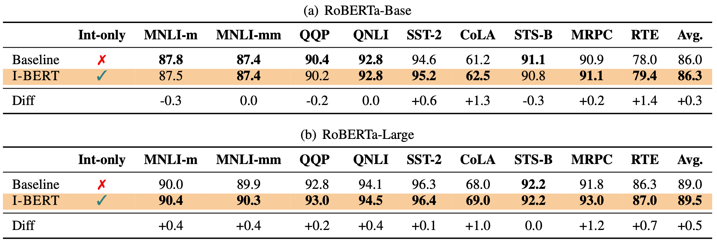
Integer-only Quantization Works: Transformers
I-BERT is integrated in HuggingFace (~8K downloads per month)
S. Kim*, A. Gholami*, Z. Yao*, M. Mahoney, K. Keutzer, I-BERT: Integer-only BERT Quantization, ICML, 2021.

Slide 50
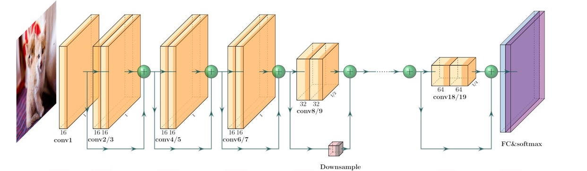
What about Sub-INT8 Quantization?
Can we go even further and perform lower precision quantization?
4-bit
4-bit
4-bit
4-bit
8-bit
8-bit
8-bit
8-bit
Uniform low precision does not work as it can significantly degrade accuracy => Use mixed-precision
- But how should we set the precision for each kernel?

Slide 51
Hessian Aware Quantization
This is somewhat similar to the Jenga game. We only remove blocks that are not sensitive.
Only use low precision quantization for insensitive parameters (flat loss landscape)
Use high precision quantization for sensitive parameters (sharp loss landscape)
This sensitivity can be calculated through Hessian which quantifies the relative sharpness/flatness of the loss landscape.
Image from UniversityCoop
Dong Z, Yao Z, Arfeen D, Gholami A, Mahoney MW, Keutzer K. Hawq-v2: Hessian aware trace-weighted quantization of neural networks. NeurIPS, 2020.
Yu S, Yao Z, Gholami A, Dong Z, Mahoney MW, Keutzer K. Hessian-Aware Pruning and Optimal Neural Implant. WACV, 2022.

Slide 52
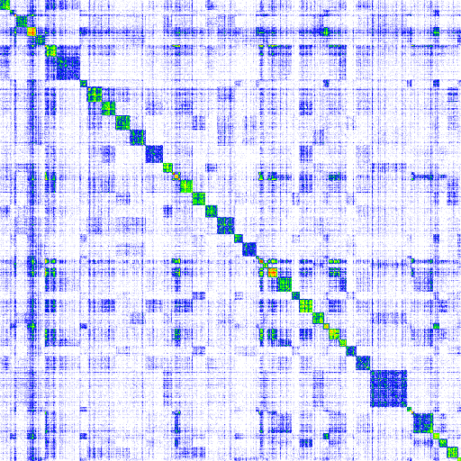
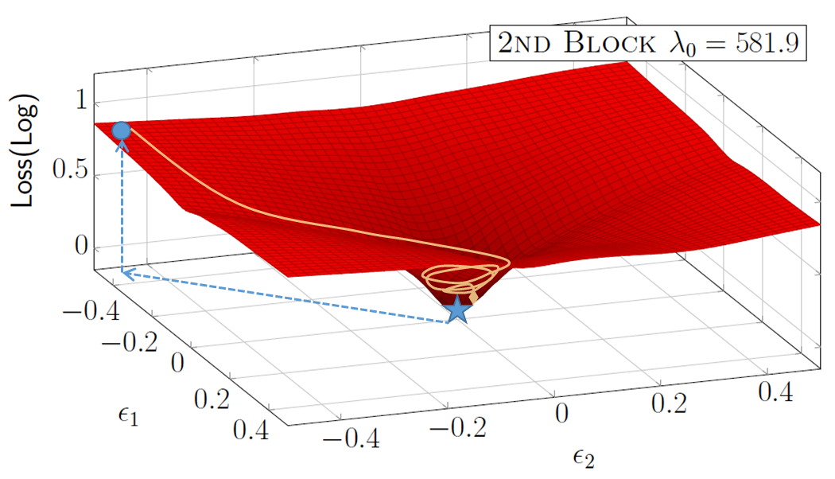
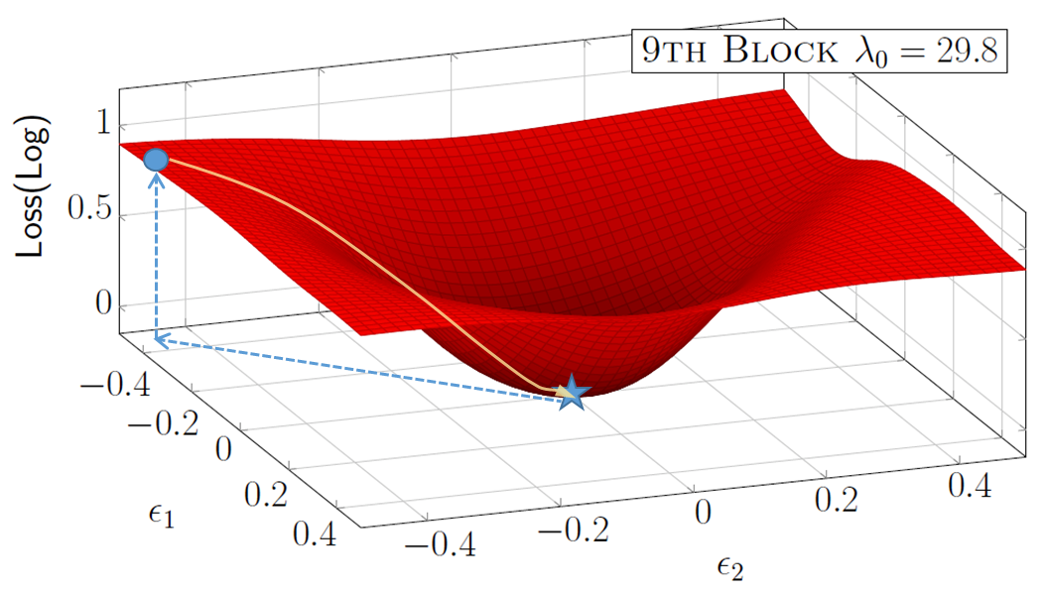
Hessian and Loss Landscape Curvature
Z. Dong, Z. Yao, D. Arfeen, A. Gholami, M. Mahoney, K. Keutzer, HAWQ-V2: Trace Weighted Hessian Aware Quantization, NeurIPS 2020.
Z. Yao*, Z. Dong*, Z. Zheng*, A. Gholami*, E. Tan, J. Li, L. Yuan, Q. Huang, Y. Wang, M. W. Mahoney, K. Keutzer, HAWQ-V3: Dyadic Neural Network Quantization in Mixed Precision, ICML, 2021.
Notes:
\text{average } tr(H) = \frac{1}{n}\sum_{i}H_{ii} = \frac{1}{n}\sum_i \lambda_i(H)

Slide 53
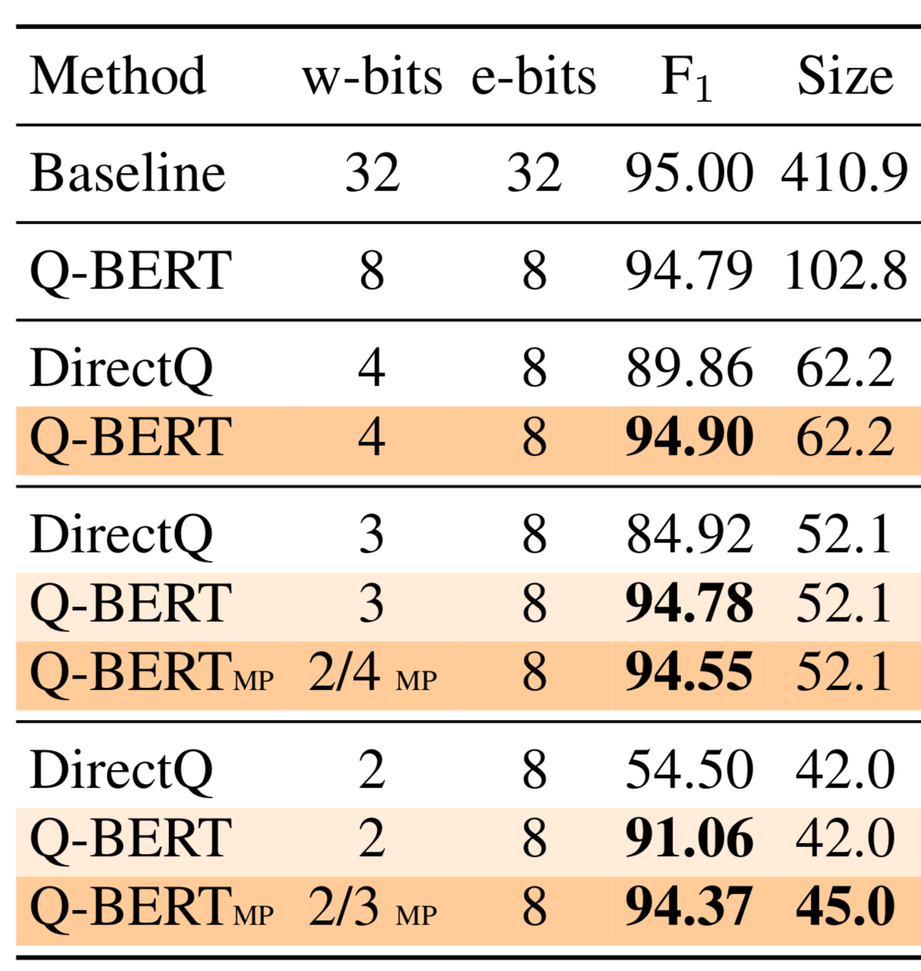
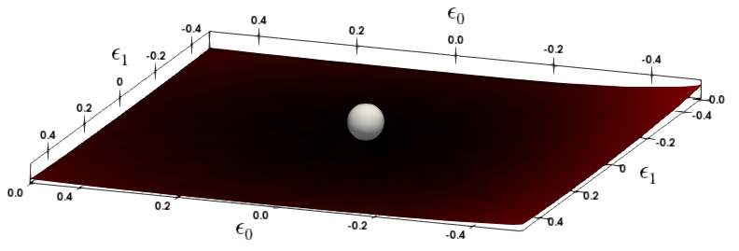
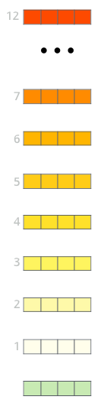
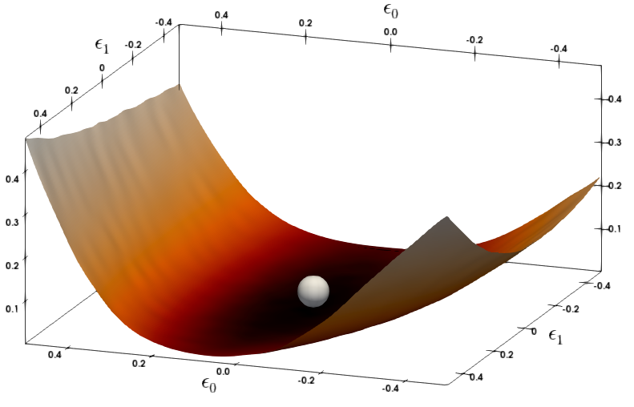
Mixed Precision Quantization for NLP
Named Entity Recognition Task
11th Layer
7th Layer
S. Sheng, Z. Dong, J. Ye, L. Ma, Z. Yao, A. Gholami, M. Mahoney, K. Keutzer, Q-BERT: Hessian Based Ultra Low Precision Quantization of BERT, AAAI, 2020.

Slide 54
Summary:
Quantization and Pruning of a model depends on the loss landscape
INT8 Quantization has been proved to be very effective for inference without accuracy degradation
Typically yields 2-4x speed up and 4x reduction in memory volume
Lower Precision Quantization is possible but often there is an accuracy/speed trade-off
Less Robust to Compression
More Robust to Compression

Slide 55
Further Reading
If you are interested to learn more about quantization see the following papers:
A survey of quantization methods for efficient neural network inference
Quantization and training of neural networks for efficient integer-arithmetic-only inference

